Slide 1
Image recognition
Part 2: Making an algorithm

Slide 2
Learning outcomes
I know that an algorithm is a set of instructions that solve a problem
I know that data in a programme is stored in variables
I can select the most relevant data for solving a problem

Slide 3
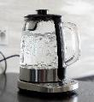
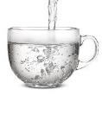

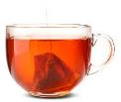
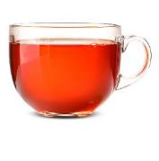
Key words
An algorithm for solving the problem of not having any tea
Step 1 Boil some water | Step 2 Pour boiled water in a cup
Step 3 Put a teabag in the cup of hot water | Step 4 Let the teabag steep.
Problem solved Now you have a cup of tea!
algorithm
A set of instructions for solving a problem.
This word is also used in maths with the same meaning.

Slide 4
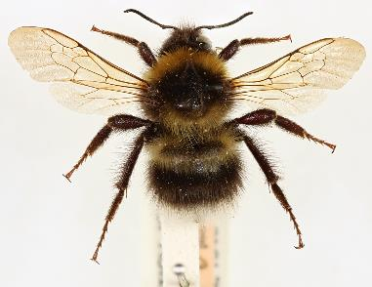
Key words
Example of an identification key
Does it have legs?
No
Yes
key
In biology, a key is a tool for identification by looking for certain characteristics.
Usually, they have a set of steps to follow. A key is a type of algorithm.
Does it have 6 legs?
Does it have eyes on stalks?
No
Yes
No
Yes
It is an insect
It is a worm
It is a slug or snail
Does it have 8 legs?
No
Yes
It is something else.
It is a spider
Use the key to identify this animal.
Notes:
In computing a key can also be described as a type of decision tree.

Slide 5
Key words
Example of an identification key
Does it have legs?
No
Yes
key
If something is ‘key’ it is important. An identification key asks the user to look for ‘key’ characteristics which are important for identification.
A dichotomous key asks the user to look at pairs of options.
Does it have 6 legs?
Does it have eyes on stalks?
No
Yes
No
Yes
It is an insect
It is a worm
It is a slug or snail
Does it have 8 legs?
No
Yes
It is something else.
It is a spider
Use the key to identify this animal.

Slide 6
Let’s turn our table of bumblebee features into a key.

Slide 7
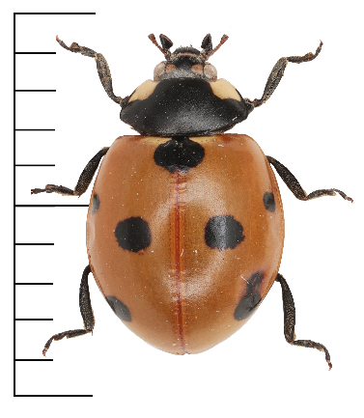
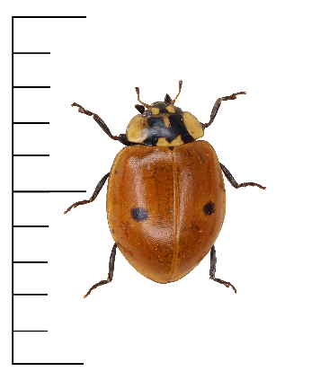
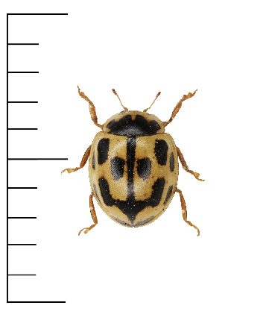
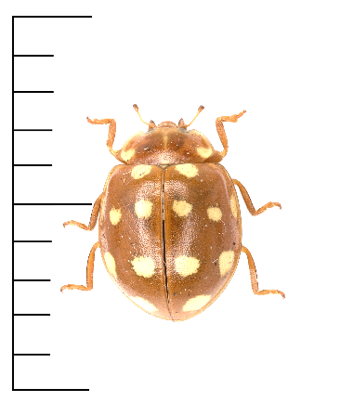
Example
Here is a completed table for 4 ladybird species.
Remember, each column is a variable. And the contents of each space is the value.
7-Spot
2-Spot
Species | Size | Colour of largest area | Colour of spots inside largest area | Colour of legs
7-Spot | 9mm | Red | Black | Black
2-spot | 6mm | Red | Black | Black
14-spot | 4mm | Yellow | Black | Yellow
Cream spot | 5mm | Orange | White | Orange
14-Spot
Cream spot

Slide 8
Example
Species | Size | Largest area | Colour of spots | Colour of legs
7-Spot | 9mm | Red | Black | Black
2-spot | 6mm | Red | Black | Black
14-spot | 4mm | Yellow | Black | Yellow
Cream spot | 5mm | Orange | White | Orange
Identify the range of values in each variable
Group variables that are numbers (like length) into a few categories.
For example, measurements could be grouped into 1-5mm, 6-10mm, 11-15mm.
>= 6mm
Red
Black
Black
around 5mm
Yellow
White
Yellow
<= 4mm
Orange
Orange
Notes:
* Group continuous variables into ranges. This turns them into discrete variables.

Slide 9
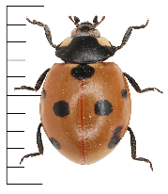
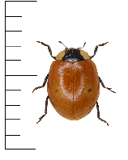
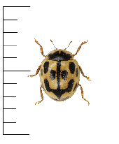
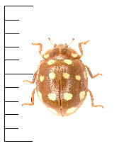
Draw connections for each species
7-Spot
Colour of largest area
Colour of spots inside largest area
Size
Colour of legs
>=6mm
Red
Black spots
Black
2-Spot
around 5mm
White spots
Yellow
Yellow
14-Spot
<=4mm
Orange
Orange
Cream spot

Slide 10
Look for options associated with only 1 species
7-Spot
Colour of largest area
Colour of spots inside largest area
Size
Colour of legs
>=6mm
Red
Black spots
Black
2-Spot
around 5mm
Yellow
White spots
Yellow
14-Spot
<=4mm
Orange
Orange
Cream spot

Slide 11
Starting with these will help make an efficient key
7-Spot
Colour of largest area
Colour of spots inside largest area
Size
Colour of legs
>=6mm
Red
Black spots
Black
2-Spot
around 5mm
Yellow
White spots
Yellow
14-Spot
<=4mm
Orange
Orange
Cream spot

Slide 12
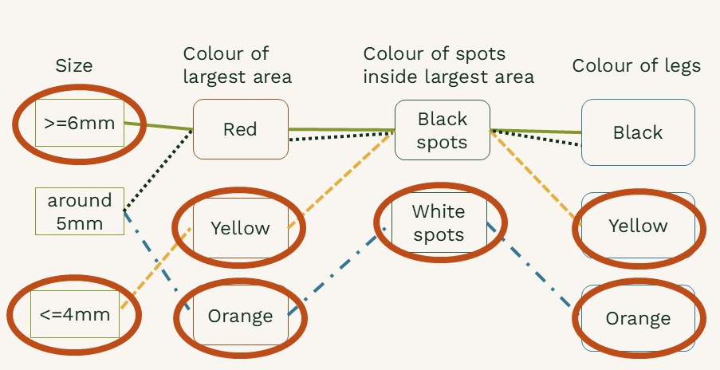
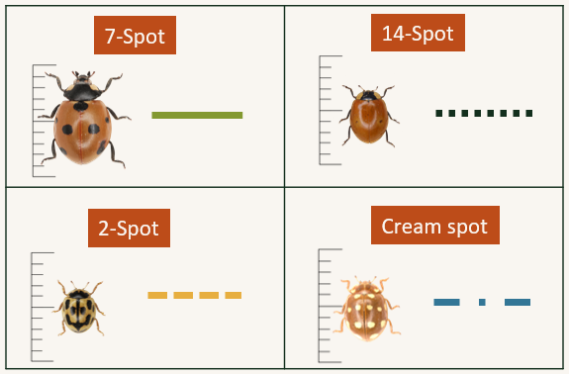
Turn the options into questions
Is the largest area yellow?
Yes
14-spot ladybird
No
Is the largest area orange?
Yes
Cream-spot ladybird
No
Is it bigger than 6mm?
Yes
7-spot ladybird
No
2-spot ladybird

Slide 13
We’ve created a key for identifying ladybirds
Is the largest area yellow?
Yes
14-spot ladybird
Our key identifies ladybirds by asking a series of questions about the ladybird we are looking at.
An algorithm is a series of steps for solving a problem.
Our key is a type of algorithm.
No
Is the largest area orange?
Yes
Cream-spot ladybird
No
Is it bigger than 6mm?
Yes
7-spot ladybird
No
2-spot ladybird

Slide 14
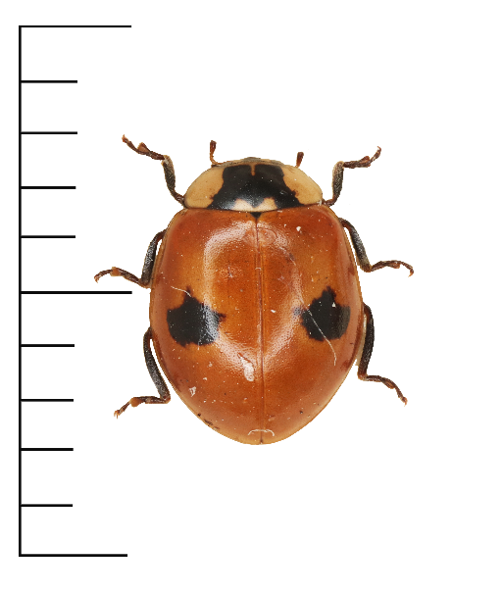
Let’s try our algorithm
Is the largest area yellow?
Yes
14-spot ladybird
This is a photo of a different 2-spot ladybird.
Does our algorithm correctly identify it?
No
Is the largest area orange?
Yes
Cream-spot ladybird
No
Is it bigger than 6mm?
Yes
7-spot ladybird
No
2-spot ladybird

Slide 15
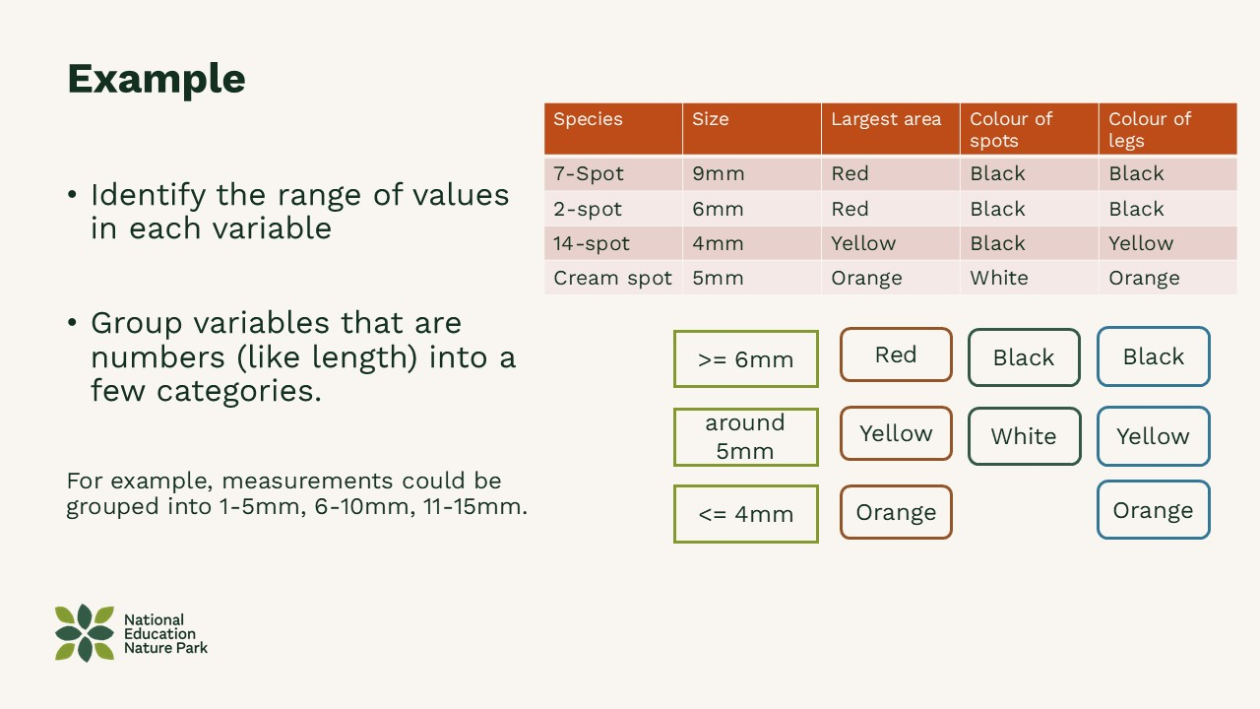
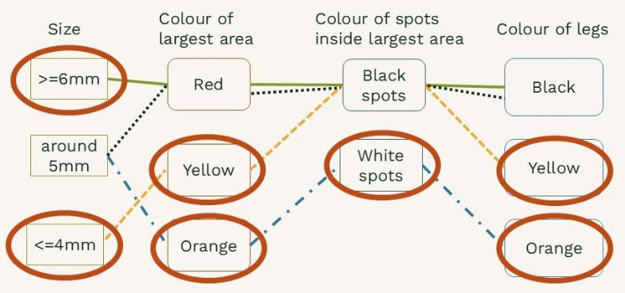
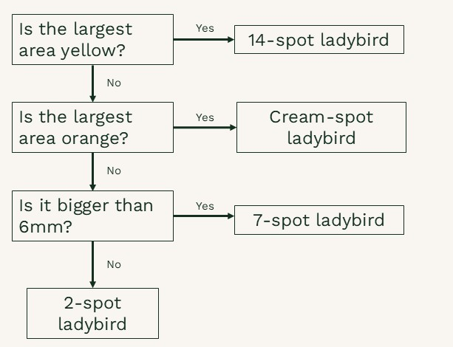
Use your bumblebee table to create a key
1.
Identify the range of options (values) in each column (variable).
  Group together values that are numbers into ranges.
Draw connections for each species.
  Identify options associated with one or only a few species.
Turn the options into questions.
2.
3.

Slide 16
Reflection question
Sometimes people see colours differently. What problems might that cause with our keys?
Do computers have the same difficulties with colour?

Slide 17
Challenge question
What are some reasons why we are asked to group together values that are numbers into ranges?
What are some reasons why we are asked to turn continuous variables into discrete variables?

